Slide 1
Microcontroller Unit
General-Purpose Input/Output (GPIO)

Slide 2
Agenda
GPIO Overview
Types of GPIO
Lesson Summary
1
2
3

Slide 3

Lesson Objectives
Understanding about input and output in microcontroller.
Be able to code use directly registers and write library to reuse.

Slide 4
GPIO OVERVIEW
Section 1

Slide 5
GPIO Overview - Agenda
1
GPIO Module Introduction
2
Knowledge of C required to use GPIO
3
Role of clock with GPIO
4
Example demo
5
Assignment

Slide 6
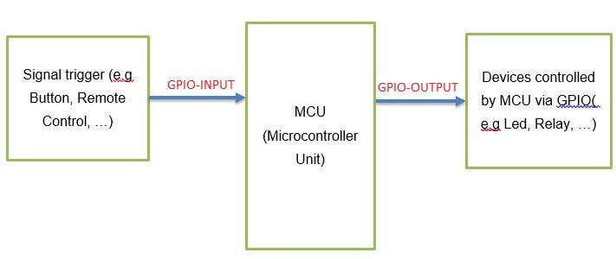
GPIO Overview
GPIO (General-Purpose Input/Output): Provide support for control devices
GPIO is used for control turning on or turning off the devices (e.g Led, Relay ...)

Slide 7
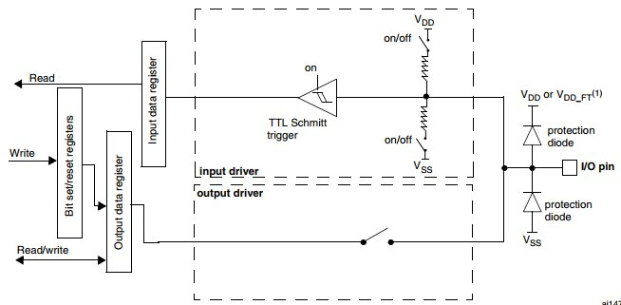
Introduction GPIO module
The general-purpose input and output (GPIO) module communicates to the processor core via a zero wait state interface (IOPORT) for maximum pin performance.
The GPIO registers support 8 bit, 16-bit or 32 bit access.
The GPIO data direction and output data registers control the direction and output data of each pin.
The GPIO input data register displays the logic value on each pin.

Slide 8
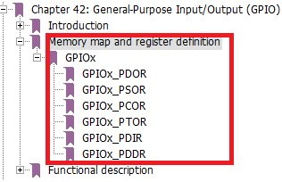
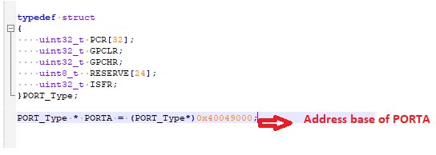
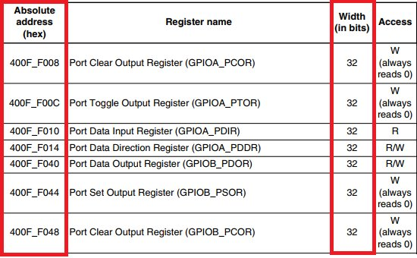
Knowledge of C required to use GPIO
Knowledge about data struct type.
Pointer.
Understand about peripheral memory map.

Slide 9
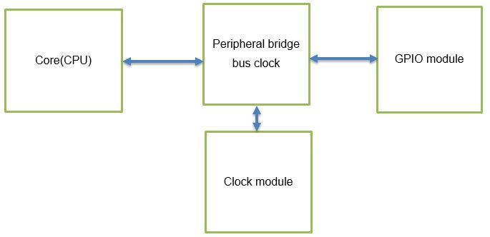
Role of clock with GPIO
The clock signal is used to maintain the synchronicity and result validity between blocks(CPU, GPIO).
Allow Core(CPU) able to be access to the registers of GPIO.

Slide 10
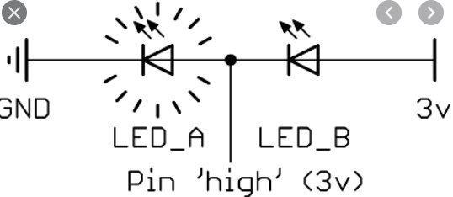
Role of clock with GPIO
It is considered as the common reference point to measure voltage against any point of the circuit and is considered to have zero voltage.
Electrical components must connect to in one way or another in order to complete the circuit.

Slide 11
Example Demo
Example demo that toggles the led D5 when pressing the button SW1 on FRDM-16Z board.
Button SW3
MKE16Z
Led Red
Pin PTD2
Pin PTB5

Slide 12
Assignment
Exercise 1:
Initialize data struct types for PORTA using memory map from mkl16 reference manual.
Exercise 2:
Set the bit field of a register of PORT A.
Exercise 3:
Get bit field of a register of PORTA.

Slide 13
Homework
Exercise:
Initialize data struct types for GPIO, PORT and PCC modules (each register is corresponding one field in data struct type)
Pass address for each pointer of the data struct types( reference the address in MKL16 reference manual).
Use the defined struct types to configure turn on the B5 led

Slide 14
Types of GPIO
Section 2

Slide 15
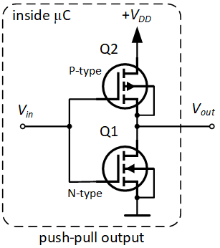
GPIO output push-pull
Push-Pull Mode: A “0” in the Output register activates the N-MOS while a “1” in the Output register activates the P-MOS.

Slide 16
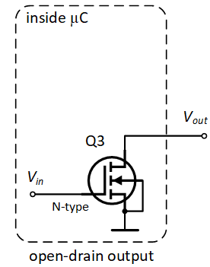
GPIO output open-drain
Open Drain Mode: A “0” in the Output register activates the N-MOS while a “1” in the Output register leaves the port in Hi-Z (the P-MOS is never activated).

Slide 17
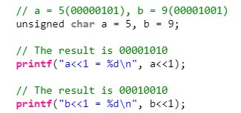
Shift operator
Left shift operator(“<<“):
Right shift operator(“>>“):

Slide 18
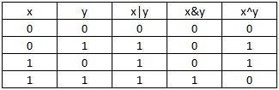
Bitwise operator
Bitwise OR: “|”
Bitwise AND: “&”
Bitwise NOT: “~”
XOR: “^”

Slide 19
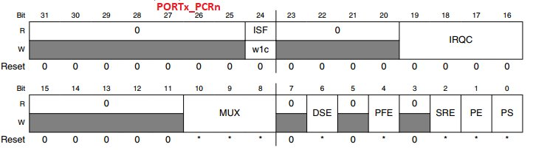
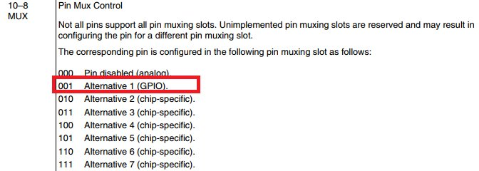
Port Control Register
Configure pin PTC29 as GPIO:
/* Clear 3 bits staring from offset 8 to 10*/
PORTE->PCR[29] &=(~(0x7 <<8));
/* Set MUX bits to 0b001= GPIO*/
PORTD->PCR[29] |= (1<<8);

Slide 20
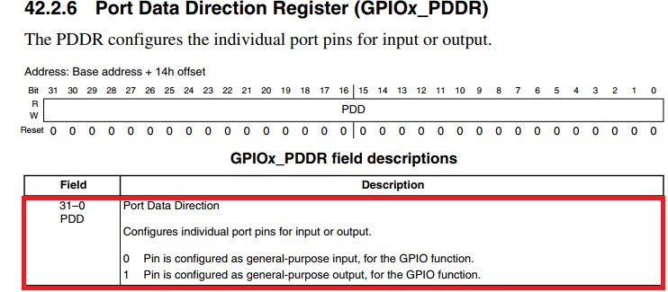
Port Data Direction Register
Configure pin PTE29 output push pull:
/* Configure PTE29 as output */
GPIOE->PDDR |= (1 << 29);

Slide 21
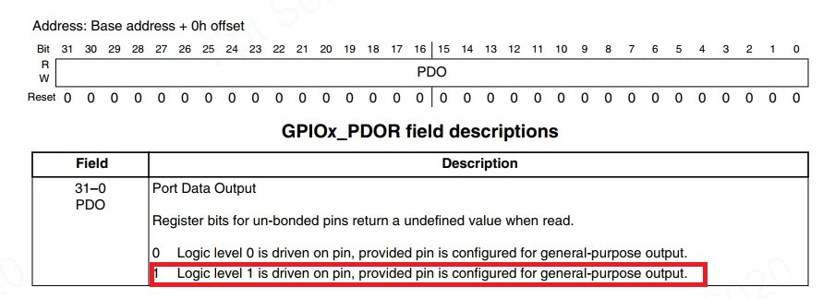
Port Data Output Register
Configure pin PTE29 to logic “1”:
/* Configure PTE29 to logic “1”*/
GPIOE->PDOR |= (1 << 29);

Slide 22
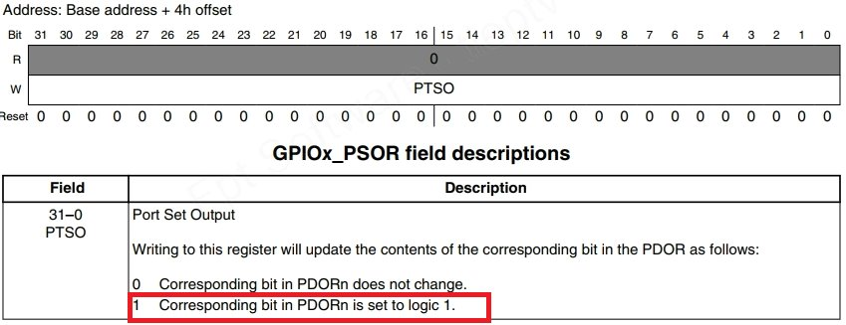
Port Set Output Register
Configure pin PTE29 to logic “1”:
/* Configure PTE29 to logic “1”*/
GPIOE->PSOR |= (1 << 29);

Slide 23
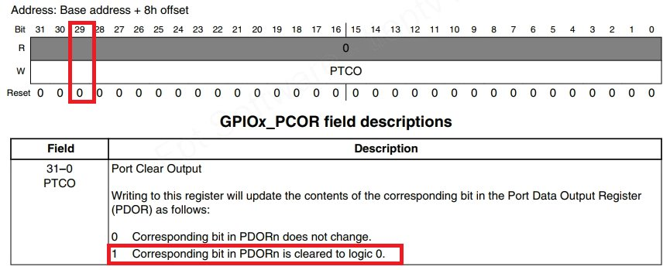
Port Clear Output Register
Configure pin PTE29 to logic “0”:
/* Configure PTE29 to logic “”*/
GPIOE->PCOR |= (1 << 29);

Slide 24
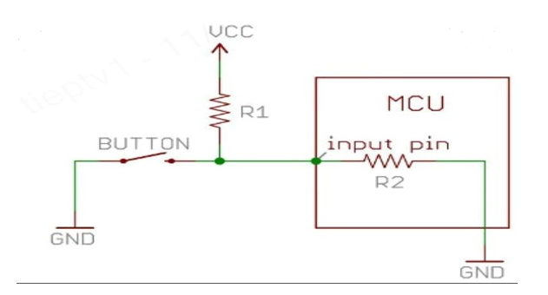
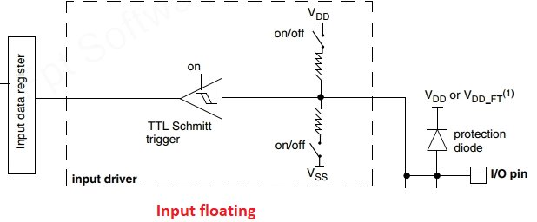
Input floating
Input floating: Pin connected neither connected to VCC or to ground.

Slide 25
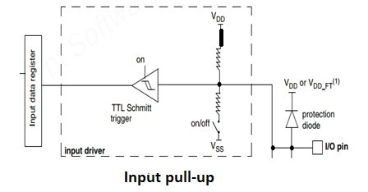
Input pull up
Input pull-up: Connected to VCC.

Slide 26
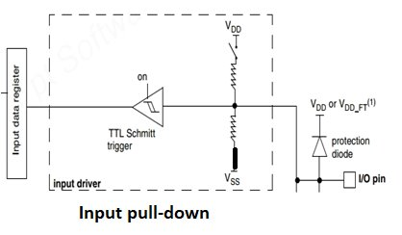
Input pull down
Input pull-down: Connected to GND.

Slide 27
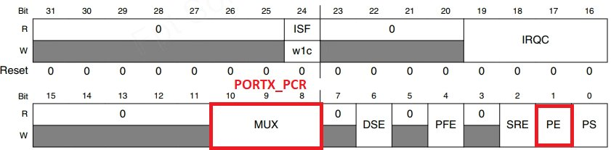
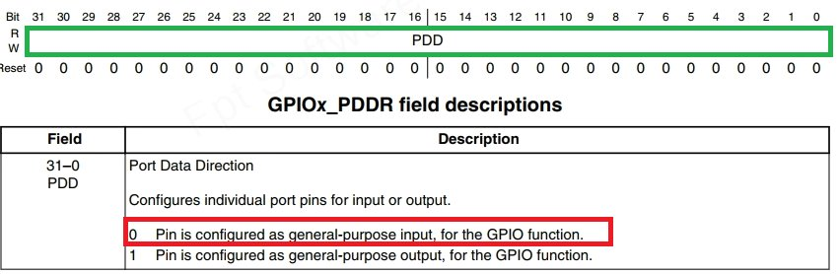
Configure GPIO pin to input floating
Step1: Configure the bit field MUX to GPIO.
Step2: Configure the bit field PE to pull-up/pull-down disabled.
Step3: Configure the bit field PDD in GPIOx_PDDR pin as input.

Slide 28
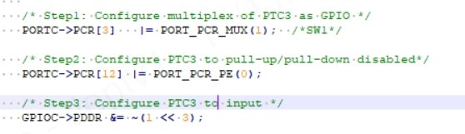
Configure GPIO pin to input floating
Step1: Configure the bit field MUX to GPIO.
Step2: Configure the bit field PE to pull-up/pull-down disabled.
Step3: Configure the bit field PDD in GPIOx_PDDR pin as input

Slide 29
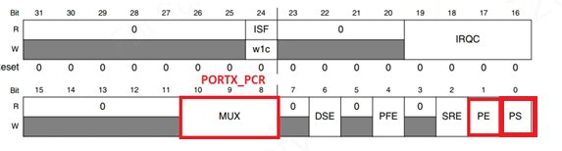
Configure GPIO pin to input pull-up
Step1: Configure the bit field MUX to GPIO.
Step2: Configure the bit field PE to pull-up/pull-down Enabled.
Step3: Configure the bit field PS to pull-up Enabled.
Step4: Configure the bit field PDD in GPIOx_PDDR pin as input

Slide 30
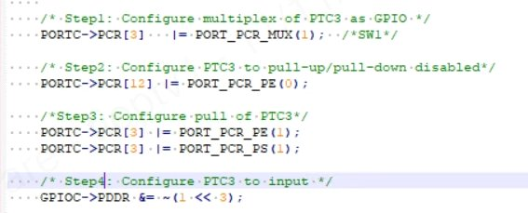
Configure GPIO pin to input pull-up
Step1: Configure the bit field MUX to GPIO.
Step2: Configure the bit field PE to pull-up/pull-down Enabled.
Step3: Configure the bit field PS to pull-up Enabled.
Step4: Configure the bit field PDD in GPIOx_PDDR pin as input

Slide 31
Configure GPIO pin to input pull-down
Step1: Configure the bit field MUX to GPIO.
Step2: Configure the bit field PE to pull-up/pull-down Enabled.
Step3: Configure the bit field PS to pull-down Enabled.
Step4: Configure the bit field PDD in GPIOx_PDDR pin as input

Slide 32
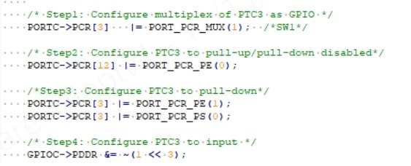
Configure GPIO pin to input pull-down
Step1: Configure the bit field MUX to GPIO.
Step2: Configure the bit field PE to pull-up/pull-down Enabled.
Step3: Configure the bit field PS to pull-down Enabled.
Step4: Configure the bit field PDD in GPIOx_PDDR pin as input

Slide 33
Lesson Summary
Overview information about GPIO.
Understanding about types of GPIO.
Know how to configure GPIO as input or output.

Slide 34
THANK YOU!

